Slide 1
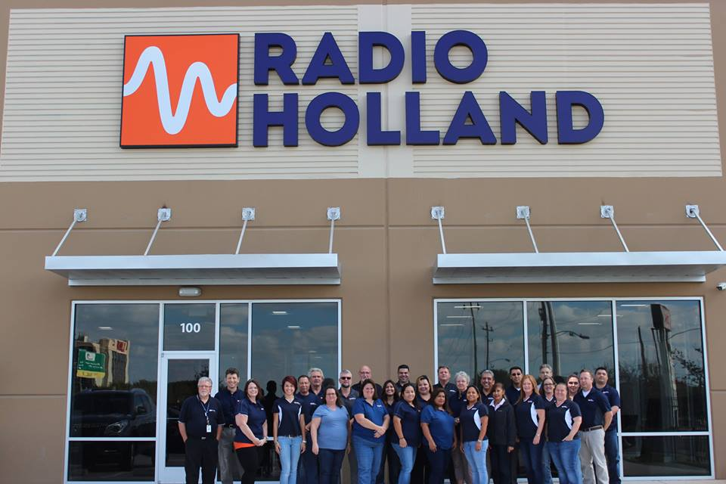
RH USA TEAM HOUSTON
Saul Hebert, Jason Couvillon, Brandi Prigmore, Nicole Floyd, Walter Johnson, Johnny Hamby, Danelle Garcia, Mark Burger, Marty Powell, Jennifer Galipeault, Patricia Milbourn, Greg Haronitis, Evelyn Torres, Syria Reyes, Christina Mathis, Fergus Campbell, Chris Taylor, Erica Gutierrez, Joe Sustaita, Inez Frank, Felix Cruz, Kristi Shipley, Jeff Bigler, Crystal Ellis, Crystal Pileggi, Gisela Crump, Todd Miller, Julio Villarreal
AFBEELDINGSOPVULLING

Slide 2
Houston Warehouse Team
Notes:
Walter, Johnny Hamby, Ryan Willette

Slide 3
Some of the Service Crew

Slide 4
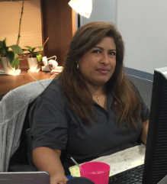
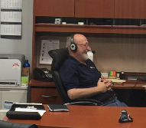
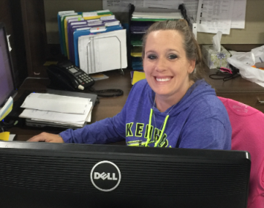
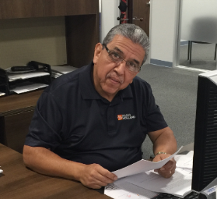
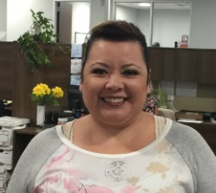
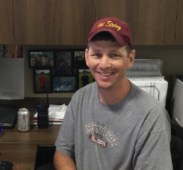
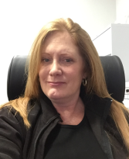
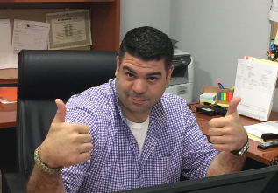
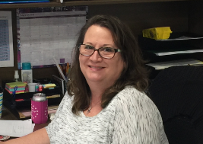
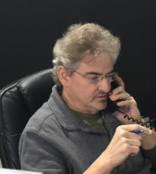
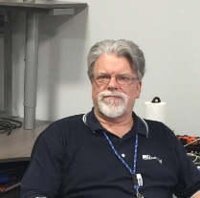
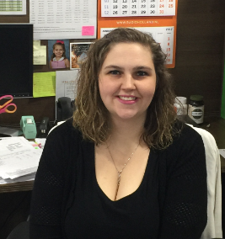
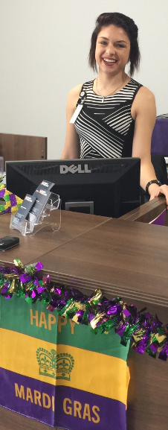
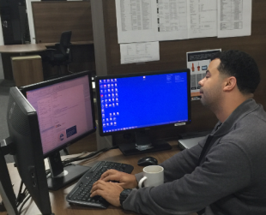
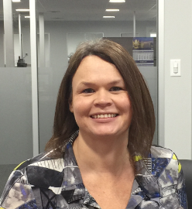
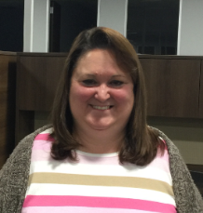
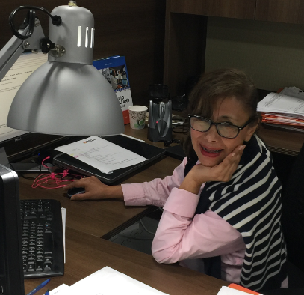
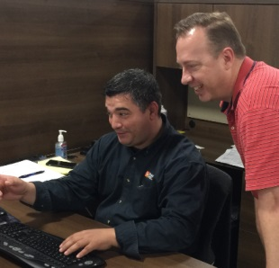
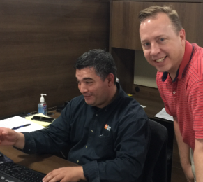
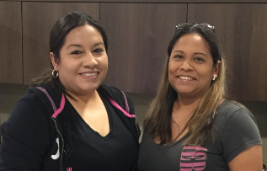
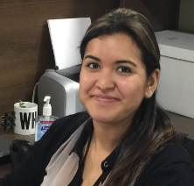
Houston, TX Crew

Slide 5
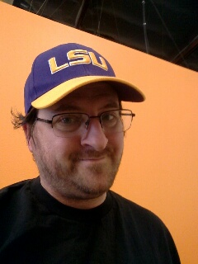
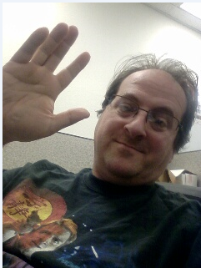
Anaheim, CA Crew
Notes:
Kevin Pitre, 1 Man Crew

Slide 6
Jacksonville, FL Crew
Notes:
Lee Brown, Adam Cole, Nancy Harris, Randy Raulerson

Slide 7
Overzicht Radio Holland USA
SEATTLE
PORTLAND
SPRINGFIELD
OAKLAND
NORFOLK
SIGNAL HILL
HARAHAN
CHARLESTON
MOBILE
HOUSTON
JACKSONVILLE
CORPUS CHRISTI
TAMPA
FT. LAUDERDALE

Slide 8
1980 USA-HOUSTON

Slide 9
U S A H O U S T O N 2016

Slide 10
USA Fort Lauderdale

Slide 11
☺ USA VESTIGING “HOLLYWOOD” ☺

Slide 12
USA HARAHAN NEW ORLEANS

Slide 13
USA Jacksonville

Slide 14
USA NEW JERSY SPRINGFIELD

Slide 15
1985 LONGBEACH PIET MUL

